Slide 1

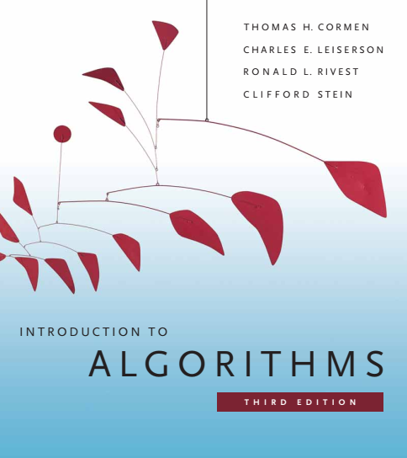
Design and Analysis of Algorithms
Dr. Sajid Iqbal
Reference Book
Introduction to Algorithms 3rd Edition By Thomas H. Cormen et. al.
https://mitpress.mit.edu/books/introduction-algorithms-third-edition
COMEDXD

Slide 2
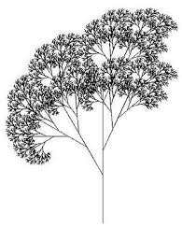
Recursion
A self repeating process

Slide 3
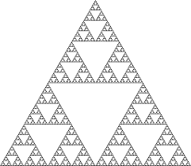

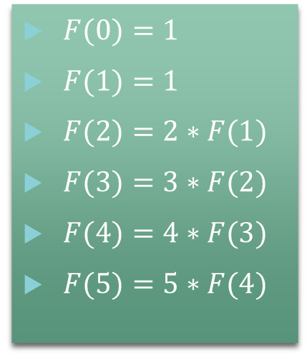
What is Recursion
A recurrence is an equation or inequality that describes a function in terms of its value on smaller inputs
The process in which a function calls itself directly or indirectly
A function showing this property is called the recursive function
Recursion occurs in mathematical process as well as in computer science
Finding a factorial is a recursive process
$F(0)=1$
$F(1)=1$
$F(2)=2∗F(1)$
$F(3)=3∗F(2)$
$F(4)=4∗F(3)$
$F(5)=5∗F(4)$

Slide 4
Recursion in Computer Science
Factorial through Iterative method
Factorial through recursive method
num=5
fact=1
If (num)<0: print(“invalid number”)
elif num==0: print(“fact is 1”)
else:
for i in range(1,num+1):
fact=num*fact
num=num-1
print(“the factorial is”, fact)
def fact(num):
If (num<0):
return 0
elif (num==0):
return 1
else:
return num*fact(num-1)
print(“fact of 5”, fact(5))

Slide 5
def fact(num):
If (num<0): return 0
elif (num==0): return 1
else:
return num*fact(num-1)
Call stack trace
5 x | Fact(4)
Call # | Stack Contents
1 | 5
2 | 4, 5
3 | 3, 4, 5
4 | 2, 3, 4, 5
5 | 1, 2, 3, 4, 5
6 | 1, 2, 3, 4, 5
Result
120
24
6
2
1
1
def fact(num):
If (num<0): return 0
elif (num==0): return 1
else:
return num*fact(num-1)
5*4*3*2*1*1
4 x | Fact(3)
def fact(num):
If (num<0): return 0
elif (num==0): return 1
else:
return num*fact(num-1)
4*3*2*1*1
3 x | Fact(2)
def fact(num):
If (num<0): return 0
elif (num==0): return 1
else:
return num*fact(num-1)
3*2*1*1
2 x | Fact(1)
1 x | Fact(0)
def fact(num):
If (num<0): return 0
elif (num==0): return 1
else:
return num*fact(num-1)
def fact(num):
If (num<0): return 0
elif (num==0): return 1
else:
return num*fact(num-1)
2*1*1
1
1*1

Slide 6
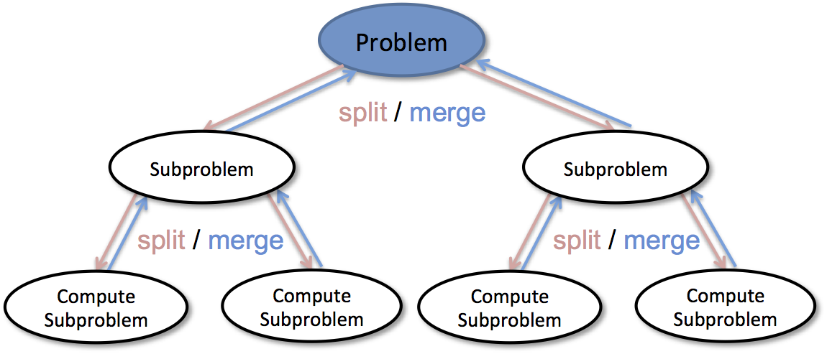
Recurrence
A recurrence can take many forms
A recurrence can break the problem in one other problem of smaller size
A recurrence can break a problem into multiple sub-problems of equal size
A recurrence can break a problem into multiple sub-problems of unequal size
Three steps of Recurrence
Divide a problem into sub-problems
Solve the sub problems
Combine the solution of sub problems

Slide 7
Types of Recursion
Indirect Recursion
A
Linear Recursion
B
Nested Recursion
N-ary Recursion
int ackerman(int m, int n)
{
if (m == 0) return(n+1);
else if (n == 0)
return(ackerman(m-1,1));
else
return(ackerman(m-1,ackerman(m,n-1))); }

Slide 8
Divide and Conquer
It is a problem solving methodology
It consists of following steps
Divide the problem into a number of subproblems that are smaller instances of the same problem.
Conquer the subproblems by solving them recursively. If the subproblem sizes are small enough, however, just solve the subproblems in a straightforward manner.
Combine the solutions to the subproblems into the solution for the original problem.
There are many problems that are solved using divide-n-conquer
Recursion is natural choice to solve such problem
Whenever you have a problem in hand, analyze it whether it could be solved using recursion

Slide 9

Thanks for watching
Dr. Sajid Iqbal
Assistant Professor
Department of Computer Science
Bahauddin Zakariya University, Multan
sajidiqbal.pk@gmail.com
Youtube Channel: COMEDXD
Allah Hafiz

